Slide 1

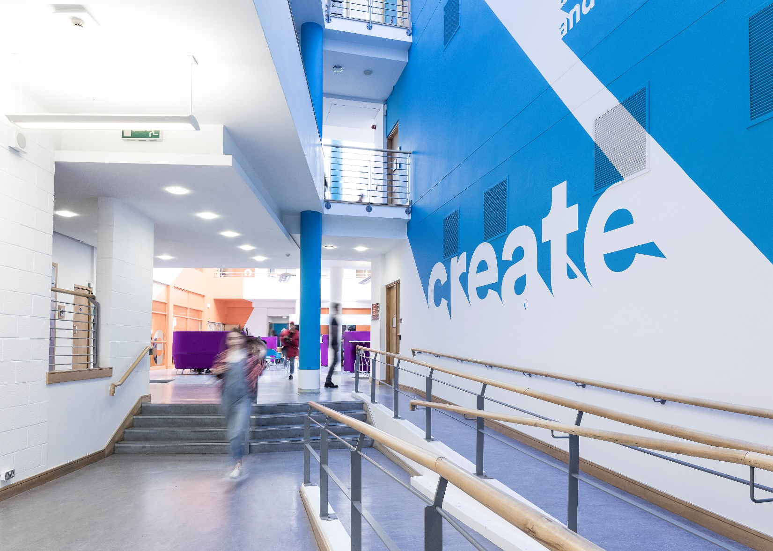

Student Survey.ie 2019
Key Findings & Opportunities
iadt.ie

Slide 2
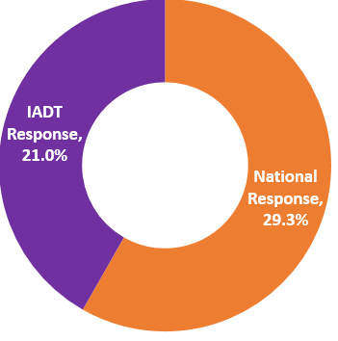

StudentSurvey.ie 2019
Nationally a total of 40,558 students responded to the 2019 survey, a response rate of 29.3%. The highest response rate to StudentSurvey.ie to date.
In IADT a total of 1,355 students responded to the 2019 survey which represents a response rate of 21%.

Slide 3
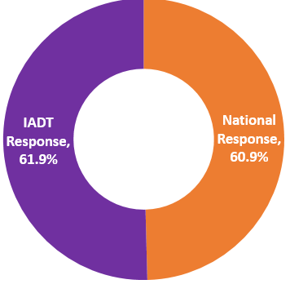
Effective Teaching Practices
61.9% of IADT students reported that they experienced teaching practices that contributed to promoting comprehension and learning (slightly higher than the national average of 60.9%).
Breakdown of IADT Responses
ENT | HUM | DVA | T+P | F+M
60.2% | 74.1% | 63.8% | 58% | 45.6%

Slide 4
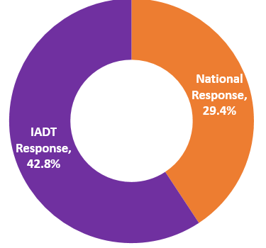
Diversity
42.8% of IADT students said they included diverse perspectives (political, religious, racial/ethnic, gender, etc.) in discussions or assignments
(higher than national average of 29.4%)
Breakdown of IADT Responses
ENT | HUM | DVA | T+P | F+M
37% | 62% | 50% | 28% | 36%

Slide 5

Equality, Diversity and Inclusion
IADT is committed to fostering an inclusive culture which promotes equality, values diversity and maintains a working, learning and social environment in which the rights and dignity of all its staff and students are respected and where every student can maximize their potential.

Slide 6

Student Engagement
Opportunities
  Promote Learning to Learn modules for First Years to focus on online learning, supporting learning style identifications and universal design for learning and teaching.
  Foster greater engagement with postgraduate students and groups.
  Integrate findings from the StudentSurvey.ie into the development of new programmes and the revision of existing programme content.
  Improve communication at all levels with our students and continue to create a partnership approach.

Slide 7
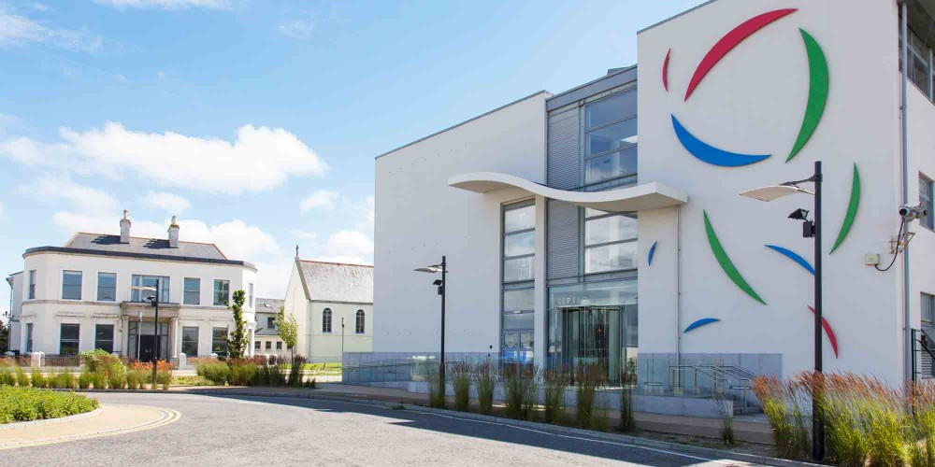
Thank you

