Slide 1
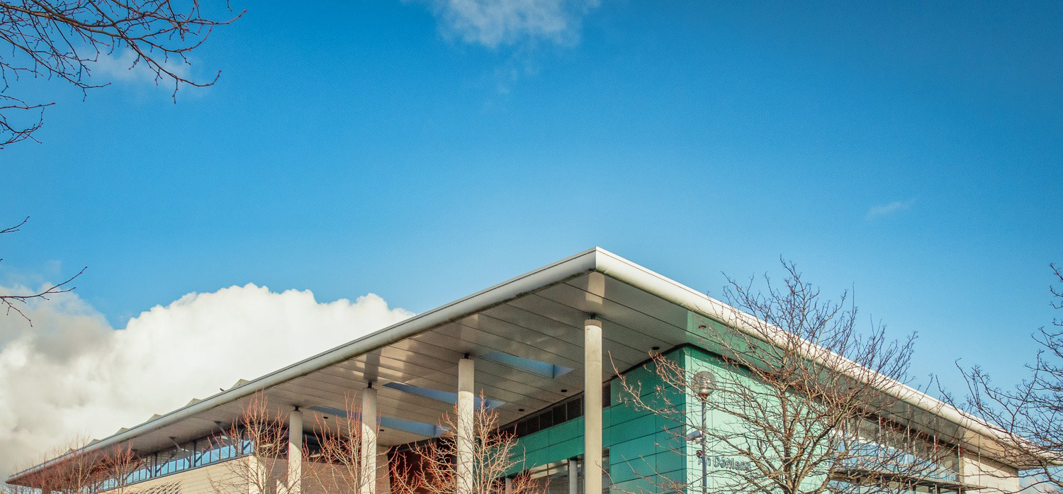


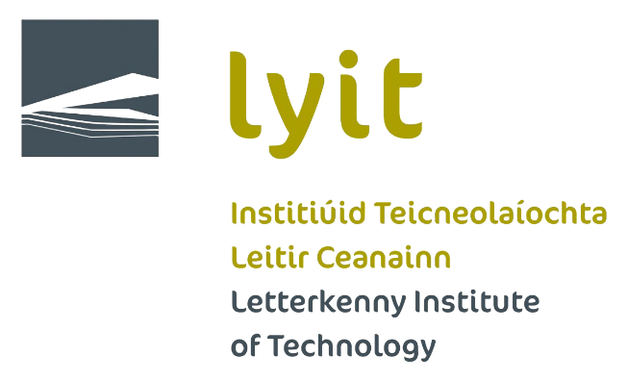

What has Studentsurvey.ie ever done for us?
Impacts- Past and Present!
Siobhán Howe (SU president) and Dr. Lydia Devenney (Postdoctoral Researcher)
Practitioners Forum 28th May 2020
Letterkenny Institute of Technology

Slide 2
Key impacts from StudentSurvey.ie
Description of Impact | How was impact achieved?
Two-week revision workshops for repeat students in mid-August each year since 2016 | Initiative co-ordinated by Students Union, Head of School of Science in co-operation with Heads of Departments and Access Office.
Extra study rooms opened up from 8.30am during exam time in January and May | Student Union officers negotiated this in co-operation with the Estates Office who attended Student Union Class Rep meetings.
Extended opening hours for Library during busy periods including continuous assessments/project hand-ups and end of semester exams | Student Union officers in negotiation with Head Librarian.
Extension of canteen opening hours and hot food availability during peak exam periods including late evenings | Achieved by Student Union officers in consultation with Head of Catering Services and Estates Office.
Creation of new student spaces around the campus and a dedicated chill-out area for students to relax and socialise | Student Union officers negotiated this in co-operation with the Estates Office who attended Student Union Class Rep meetings.
#Fresher6 – 6 week Extended Induction Programme which takes a different theme each week | Schools Engagement Officer in co-operation with Students Union and Head of Teaching & Learning

Slide 3



Impacts on UNLOCK
Intervention and Tracking
Staff and Student Training
Templates
Shift the culture

Slide 4

Questions?
The UNLOCK project
Contact: Lydia.Devenney@lyit.ie or Joe.English@lyit.ie
Telephone: 0833686583

