Slide 1


Impacting the DCU Student Experience through Studentsurvey.ie
Empower
Foster a Culture
Closing the loop

Slide 2
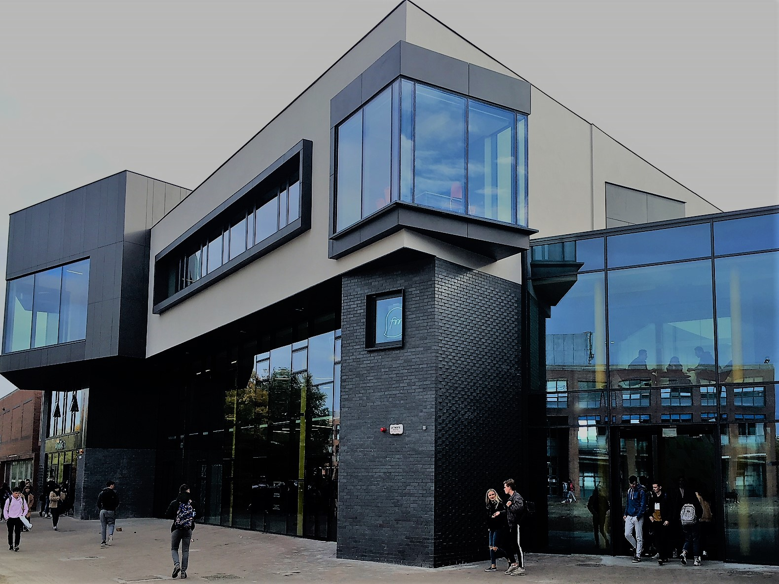

PROVIDING A SUPPORTIVE ENVIRONMENT
The U Student Centre
Java – Social Space, SPD

Slide 3

CHALLENGES & LESSONS

Slide 4

Thank you for listening!
Ms Celine Heffernan
DCU Quality Promotions Officer
E: celine.Heffernan@dcu.ie
Ms. Christine Farrell
DCU SU President
E: president@dcusu.ie

