Slide 1
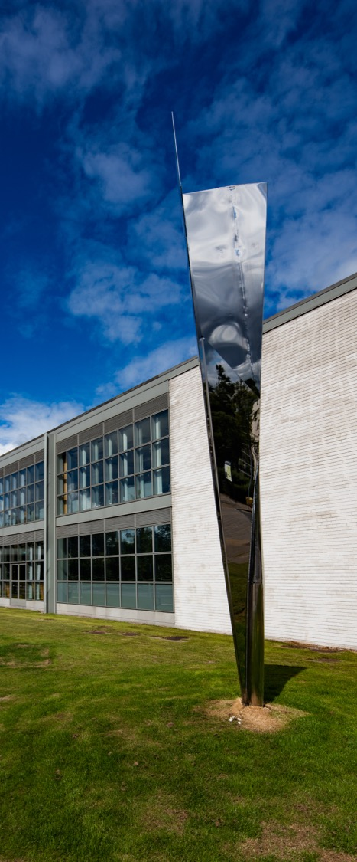

DkIT Students’ Union, Registrar’s Office and Centre for Excellence in Learning and Teaching.
Using data from StudentSurvey.ie to understand what engages DkIT students.
Notes:
We are going to tell you briefly about one of the ways in which we have used StudentSurvey.ie responses to better understand what engages students at DkIT

Slide 2
Two open-ended questions
What does your institution do best to engage your students in learning?
What could your institution do to improve students’ engagement in learning?
Responses consistent since 2014.
Notes:
We have found tow open-ended questions particularly useful: ‘What does your institution do best to engage your students in learning?’ and ‘What could your institution do to improve students’ engagement in learning?’ The responses have been remarkably consistent over the years and paint a clear picture of what engages DkIT students.

Slide 3
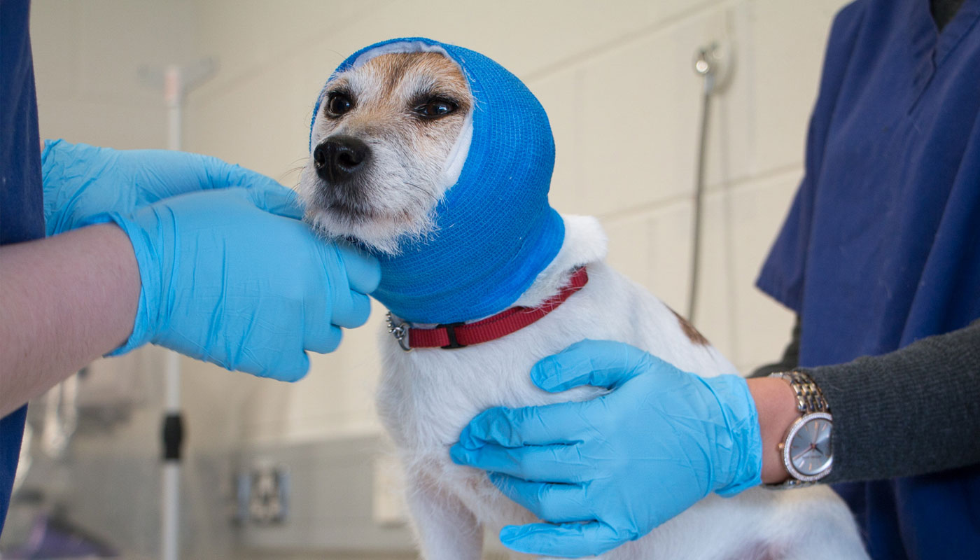

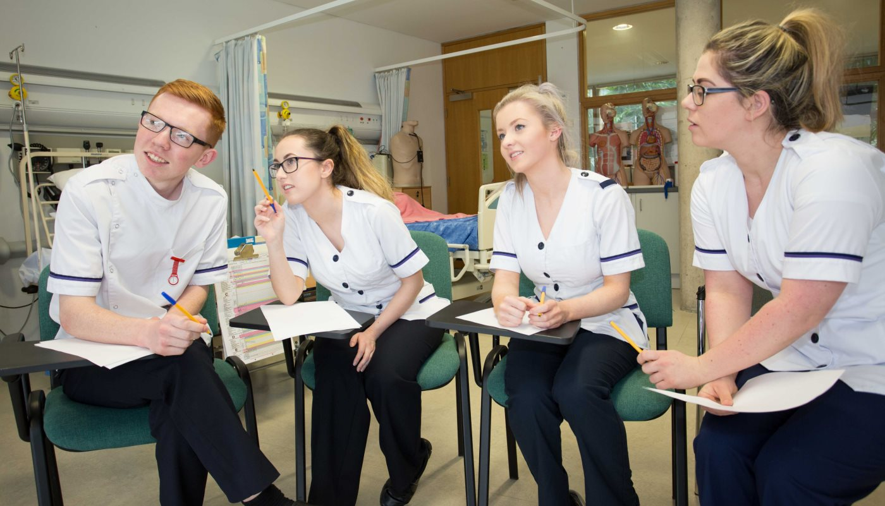
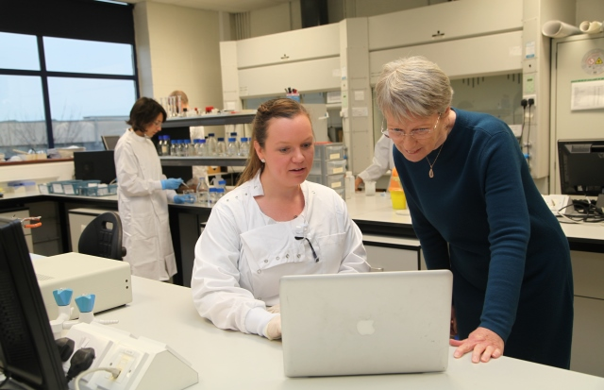
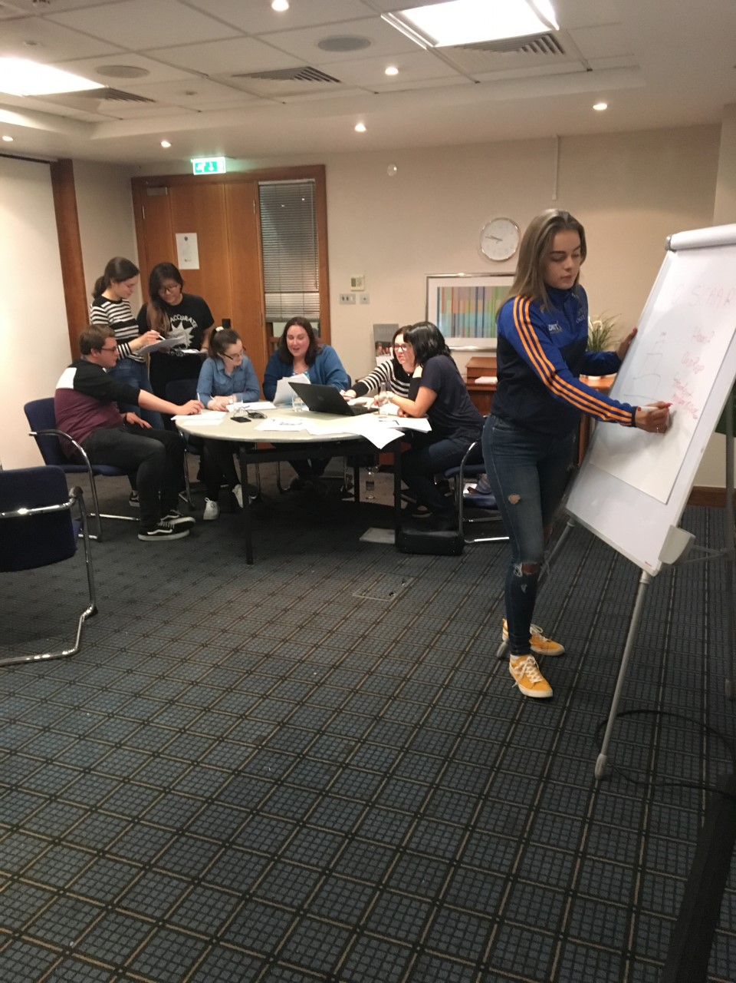
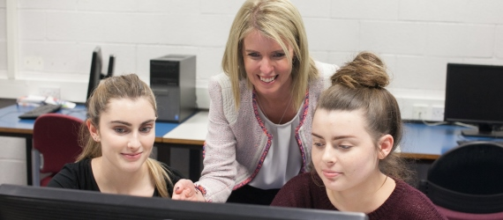
What engages our students?
Notes:
Our students value active learning and teaching methods with a practical focus, good relationships with supportive lecturers and a supportive environment. You can see here some images of DkIT activity that capture that.

Slide 4
They say…
More discussions during lectures
Encouragement, support facilities and academic guidance
Smaller classes means for individual attention to students from lecturers. This makes a massive difference to students
More work related experiences
Lecturers relate classes to real life situations in the workplace
Good lecturers who make class fun and interesting and in turn engage the whole class
More interaction
Interactive lecturers and practical classes
More practicals
Notes:
Here are some quotes to give you a flavour of what our students say. The green call-outs include responses to the question ‘what does your institution do best to engage students?’ while the red include responses to ‘What could your institution do to improve?’ You can see that they all show that our students are engaged by interactive classes, a practical focus and supportive environment,

Slide 5
How does this help us now?
The face-to-face environment has been important in promoting good relationships and a supportive environment.
This has also helped us to transition to remote learning and teaching over the past 10 weeks.
Knowing what engages our students helps staff and students to plan for a much more blended delivery in the coming year.
Promoting and maintaining supportive relationships and an active, practical focus will be crucial.
Notes:
As a small, friendly campus, we appreciate how much f2f contact has helped us to promote good relationships and a supportive learning community. This has been important in helping us to shift to remote delivery over the past couple of months. It will be challenging to maintain these as we shift to a more online environment over the next academic year, however the feedback from studentsurvey.ie we have discussed is being used, along with other evidence, to guide our planning. Knowing what engages our students helps us all to plan for a more blended delivery. Promoting and maintaining supportive relationship and an active, practical focus will be very important.

