Slide 1


TU Dublin and Studentsurvey.ie
Impact and Results
Practitioner’s Forum 28th of May 2020

Slide 2


TU Dublin: Data
33% or 4785 Students
What we want to do to increase the impact of the Survey:
Maintain participation
Keep message consistent across TU Dublin's Campuses
Extend promotion over two semesters
Raise awareness of results and actions with Students
Allow Students to lead in the promotion of results

Slide 3

TU Dublin Results and Impact Plans for 2020/21
Focus on: Specific IGTV/Instagram posts moving to year round promotion in three Stages: Feb-March: September- October: November- January:
Why: IGTV video’s worked very successfully in February and March promotions, there cheap and quick to produce, timely, focused on particular areas, such Health and Assessment, don’t need to be polished, do need to be interesting and relevant.
How: three Groups of Video Clips
Stage 1: promotion (take the survey)
Stage 2: thank you here are the results
Stage 3: Student led video’s on universities actions

Slide 4
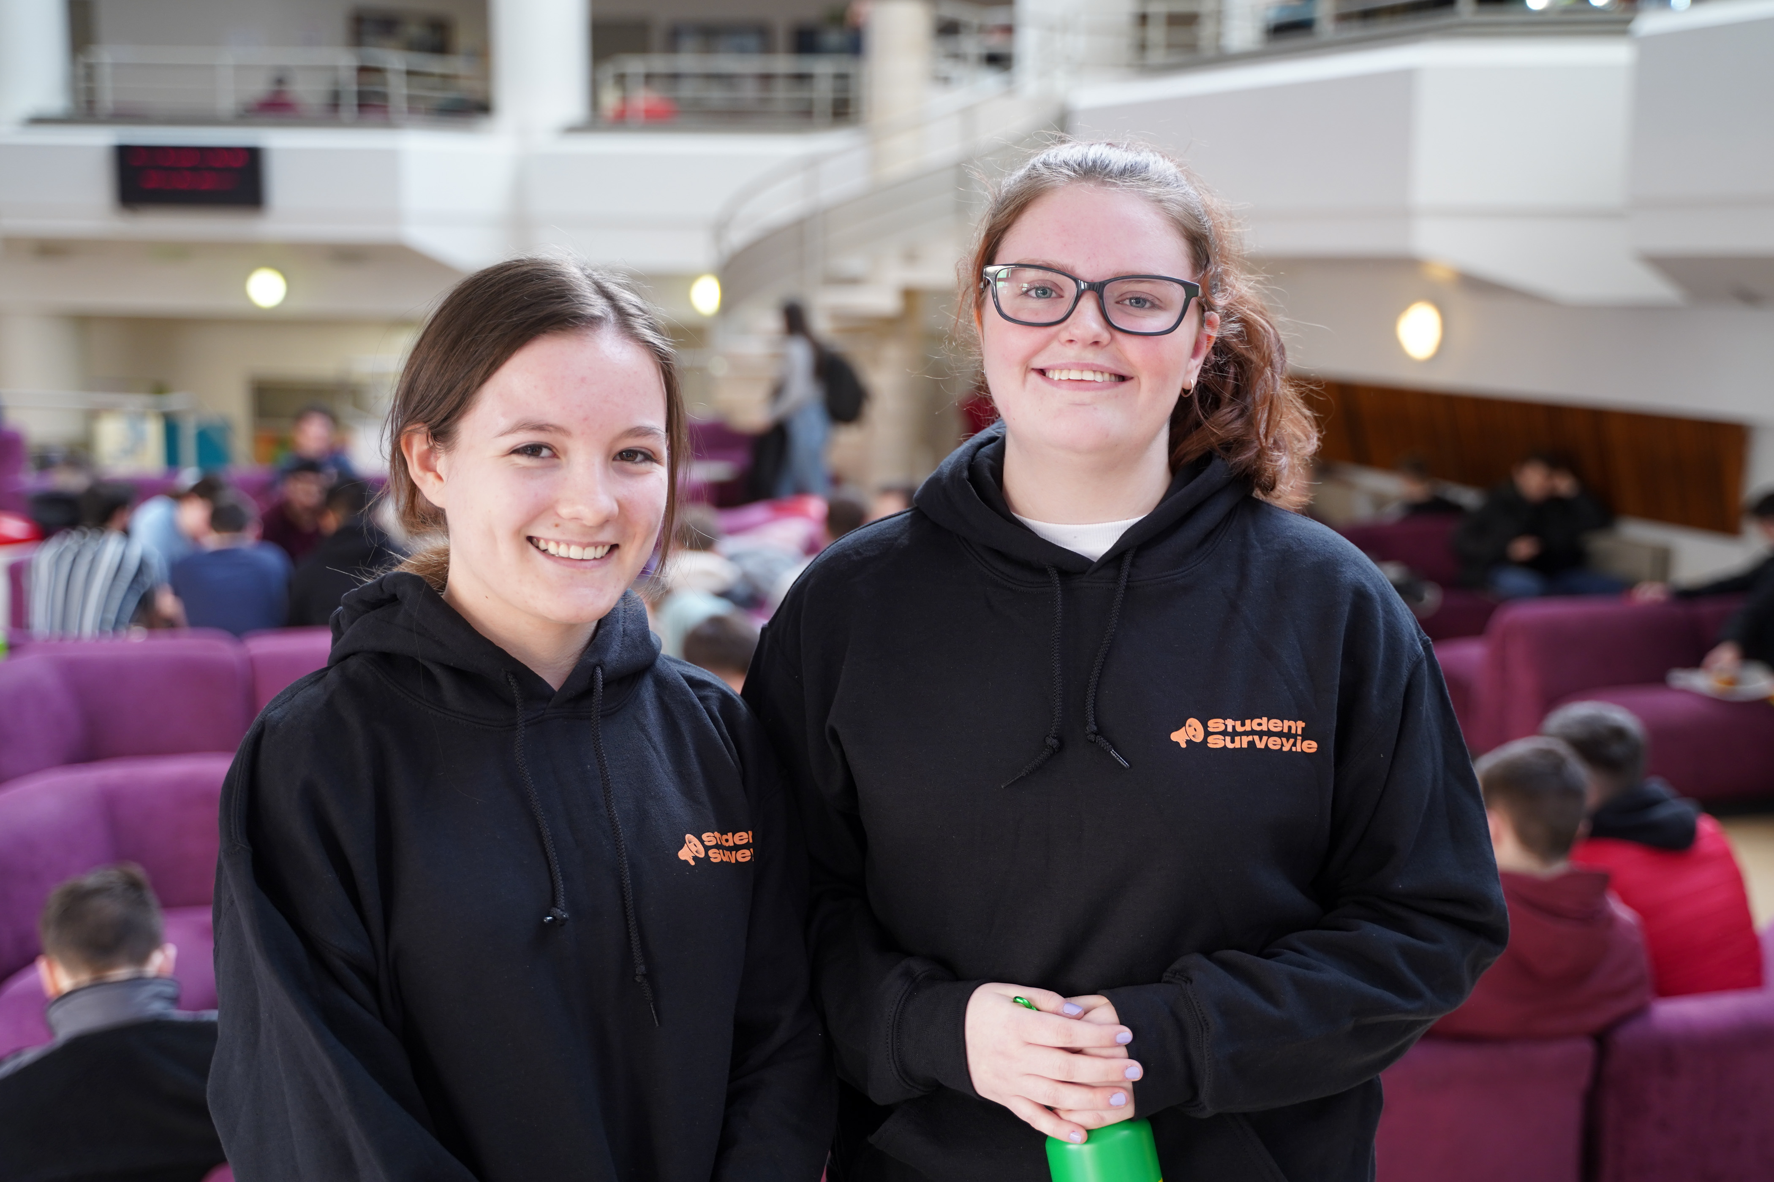
TU Dublin: Stage 2 Here’s one we made earlier!
https://www.dropbox.com/s/qc32eyrpx2ux1sm/052020%20Webinar%20v7_sml.mp4?dl=0

